Slide 1
Notes:
Mark - John Mark, friend of peter
First book written in NT - Christ and ministry
The story of God’s entrance into human history
All about the good news
Ppl think Xianity restrictive
But really it’s wonderful news
Before we hit good news, must hit bad
There’s a probem G is trying to solve
Don’t we sense sumth wrong with world and us?

Slide 2
The decline in mental health
The youngest generation 5 times more likely to have anxiety/depression
America’s “anxiety score” increased 41% since 2016
2 in 5 Americans report feeling “isolated”
Loneliness has the same impact on mortality as smoking 15 cigarettes a day
Notes:
Twinge, psychology today
psychiatry.org
Douglas Nemecek, M.D., chief medical officer for Behavioral Health at Cigna.
“”

Slide 3
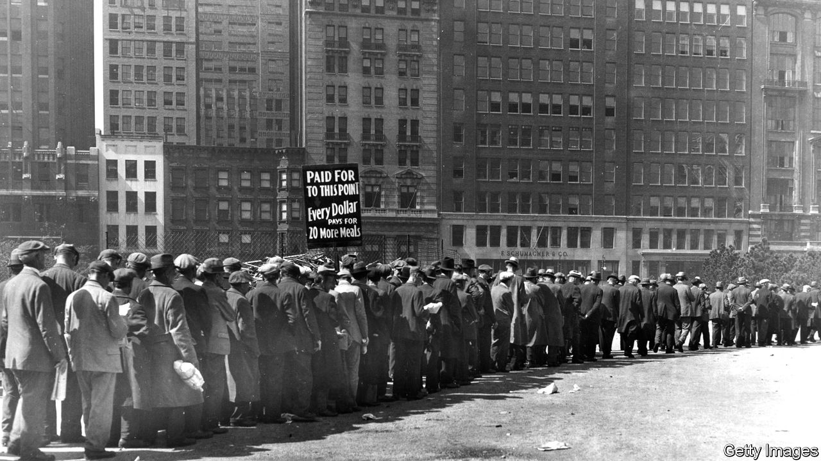
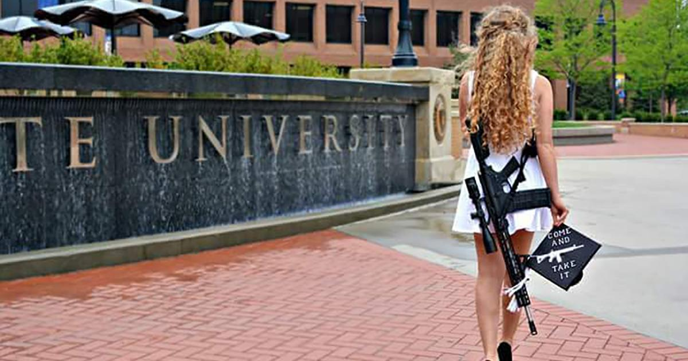
What are we anxious about?
Health
Safety
Finances
Politics
Relationships
Notes:
Psychology.org
In all: the chaotic world
Healthcare so expensive!
School shootings!
Am I gonna make enough money?
We are so divided! Trump ruining us!
Will I ever find love? How come I’m so lonely?
This is what we can all agree on - there are problems
These arent going away any time soon
With techology, better mental health resources
I’m not here shilling a cure-all solution - just gimme your money
But problem deeper than symptoms
Something broken within that needs solved
Good news is there’s help… (slide)

Slide 4
Mark 1
The beginning of the gospel of Jesus Christ, the Son of God. As it is written in Isaiah the prophet
Notes:
Good news! God is involved
Not a weird transcendant being
Depressed ppl get help by knowing not alone
The CREATOR OF UNIVERSE is involved too

Slide 5
Mark 1
The beginning of the gospel of Jesus Christ, the Son of God. As it is written in Isaiah the prophet
Notes:
The son of God - title for missiah
This is God come to Earth himself
Like thanos - I’ll do it myself
This was all part of a plan that spans the entire Bible
Not just loose collection of stories, advice
Ex: I thought this as a kid - be good, don't be bad, here’s some examples
For 1000s of yrs building to this point
“Written in Isa” - OT
We have old manuscripts of these predictions
Why care? What if someone told u evth gonna happen to u next week
U say “please tell me more”
Or “I get it, eat hot pockets in dorm room
OT has these predictions… (slide)

Slide 6
Isaiah 9:6
For a child will be born to us, a son will be given to us;
And the government will rest on His shoulders;
And His name will be called Wonderful Counselor, Mighty God, Eternal Father, Prince of Peace.
Isaiah 52:13-15
Behold, My servant will prosper,
He will be high and lifted up and greatly exalted.
14 Just as many were astonished at you, My people,
So His appearance was marred more than any man
And His form more than the sons of men.
15 Thus He will sprinkle many nations,
Notes:
Isa 9:6 - he would be God!
Isa 52 - gonna be lifted up… but also suffer
Sprinkle - all about cleansing
Many more - about ruling king but also gonna be crucified
Who the H is this guy? How make sense?
Let’s watch video

Slide 7
Notes:
Vid summary
Sickness at beginnign sin
Messiah come and fix it by dying
MUST die first to make us right
THEN will fix the world
So mark here is how this was accomplished… (slide)

Slide 8
Mark 1
“Behold, I send My messenger ahead of You,
Who will prepare Your way;
3 The voice of one crying in the wilderness,
‘Make ready the way of the Lord,
Make His paths straight.’”
4 John the Baptist appeared in the wilderness preaching a baptism of repentance for the forgiveness of sins.
Notes:
Crying in wilderness - JtB
Preparing a people for JC - was also predicted
Repentance - not the churchy word u think
Just means change your mind
Ex: Kid in ec class
Still acting like high schooler
Had to repent - change mind. Not a high schooler anymore
Needed a ppl ready to receive
Gotta realize you need help!
We gotta change our minds too - maybe cant do this on own
Maybe we need help
NOT OK the way I am
God’s wiling to deal w our sickness
GRACE! Free gift.. (slide)

Slide 9
Mark 1
“Behold, I send My messenger ahead of You,
Who will prepare Your way;
3 The voice of one crying in the wilderness,
‘Make ready the way of the Lord,
Make His paths straight.’”
4 John the Baptist appeared in the wilderness preaching a baptism of repentance for the forgiveness of sins.
Ephesians 2:8,9
8 For it is by grace you have been saved, through faith—and this is not from yourselves, it is the gift of God— 9 not by works, so that no one can boast.
Notes:
Ephesians 2:8,9
Can’t earn it, free gift
Must receive
Why do we have to recieve this to find healing from our sickness? Alex tell us

Slide 10
Mark 1:5
And all the country of Judea was going out to him, and all the people of Jerusalem; and they were being baptized by him in the Jordan River, confessing their sins.

Slide 11
Mark 1:6
John was clothed with camel’s hair and wore a leather belt around his waist, and his diet was locusts and wild honey.

Slide 12
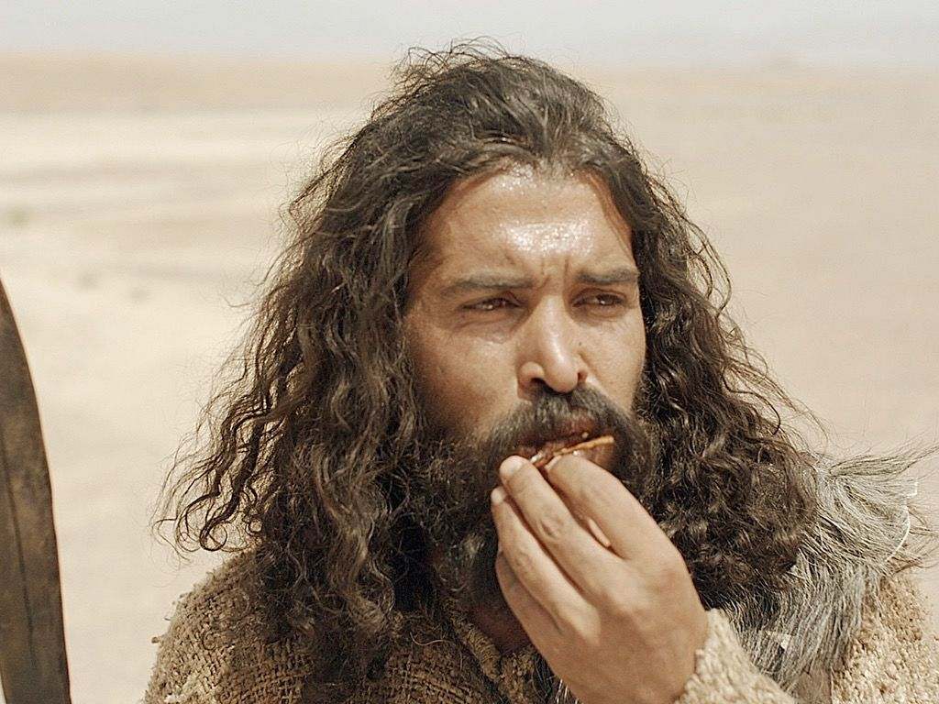

Slide 13
Three-Part Cycle
Self-Rule - Sin
Depression - Guilt
Anxiety - Fear

Slide 14
Mark 1:7-8
And he was preaching, and saying, “After me One is coming who is mightier than I, and I am not fit to stoop down and untie the thong of His sandals. I baptized you with water; but He will baptize you with the Holy Spirit.”

Slide 15
One-Part Solution
Change Your Mind - Repentance

Slide 16
Therefore (change your mind) and return, so that your sins may be wiped away, in order that times of refreshing may come from the presence of the Lord.
-Acts 3:19

Slide 17
And Jesus answered and said to them, “It is not those who are well who need a physician, but those who are sick. I have not come to call the righteous but sinners to repentance.”
-Luke 5:31-32

Slide 18
One-Part Solution
Change Your Mind - Repentance

Slide 19
One-Part Solution
Change Your Mind - Repentance
God’s Response
Puts us into the Holy Spirit - Baptism

Slide 20
Mark 1:7-8
And he was preaching, and saying, “After me One is coming who is mightier than I, and I am not fit to stoop down and untie the thong of His sandals. I baptized you with water; but He will baptize you with the Holy Spirit.”

Slide 21
Mark 1:7-8
And he was preaching, and saying, “After me One is coming who is mightier than I, and I am not fit to stoop down and untie the thong of His sandals. I put you into water; but He will put you into the Holy Spirit.

Slide 22
We love because he first loved us.
-1 John 4:19

Slide 23
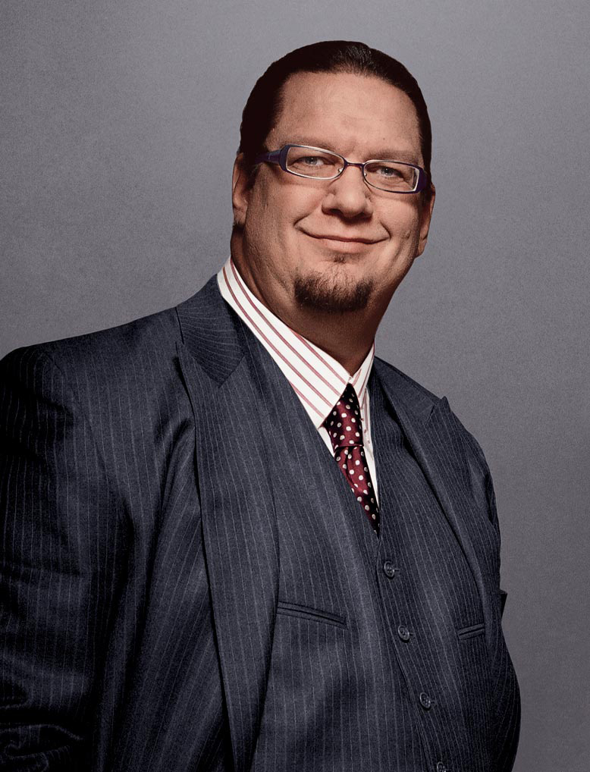
"… I don’t respect people who don’t (share their faith)… If you believe that there’s a heaven and a hell, and people could be going to hell or not getting eternal life, and you think that it’s not really worth telling them this because it would make it socially awkward… How much do you have to hate somebody to believe everlasting life is possible and not tell them that?"
-Penn Jillette, Magician / Atheist

Slide 24
Questions? Comments?
Summary:
The world is not how it should be.
Good News! God’s involved. He cares.
God has been involved from the very beginning- he gives us evidence: verifiable, fulfilled prophecies
His plan culminates in Jesus Christ, who John the Baptist announced. Now, we can all know God personally and be in a relationship with him for free.
The Three-Part Cycle:
Self-Focus - Sin
Depression - Guilt
Anxiety - Fear
The One-Step Solution:
Change Your Mind - Repentance
The Result: Being Put Into the Holy Spirit:
Exciting, deep relationships
See life clearly
Peace in our hearts forever
Opportunities to serve

